Slide 1
Press the F5 button on your keyboard to start the tutorial

Slide 2
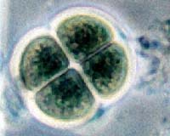
Meiosis Tutorial
Get Started
Interphase
Prophase
Metaphase
Anaphase
Telophase
Mitosis Quiz
Now for Meiosis
Germ cells
Interphase
Prophase 1
Tetrads
Crossing Over
Metaphase 1
Anaphase 1
Telophase 1
Prophase 2
Place your keyboard aside.
Metaphase 2
Anaphase 2
Use your mouse to navigate.
Telophase 2
Meiosis Quiz

Slide 3
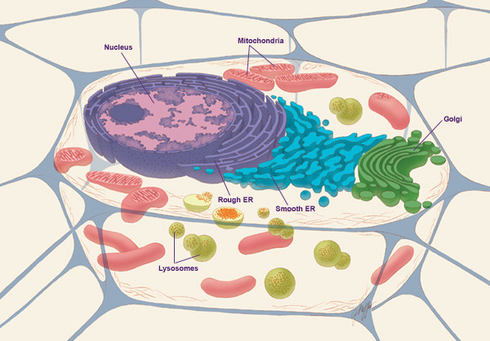
Mitosis Review
Go Back
Home
All cells will eventually get old and die. Therefore, cells must divide in order to replace old and dying cells.

Slide 4
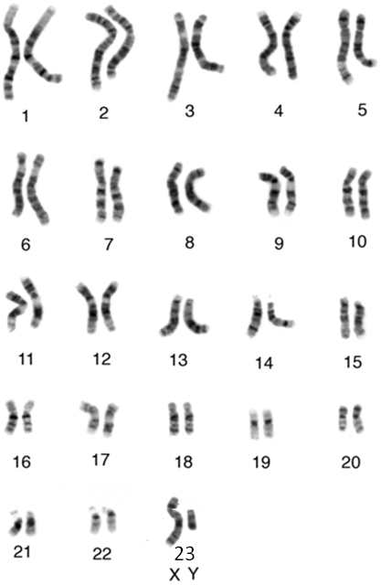
Mitosis Review
Go Back
Home
All cells will eventually get old and die. Therefore, cells must divide in order to replace old and dying cells.
Mitosis is the process of how diploid cells divide. Diploid cells are cells with the complete set of chromosomes for that species.

Slide 5
Mitosis Review
Go Back
Home
All cells will eventually get old and die. Therefore, cells must divide in order to replace old and dying cells.
Mitosis is the process of how diploid cells divide. Diploid cells are cells with the complete set of chromosomes for that species.
For example, humans have a complete set of 46 chromosomes in diploid cells.

Slide 6
Mitosis Review
Go Back
Home
All cells will eventually get old and die. Therefore, cells must divide in order to replace old and dying cells.
Mitosis is the process of how diploid cells divide. Diploid cells are cells with the complete set of chromosomes for that species.
For example, humans have a complete set of 46 chromosomes in diploid cells.
In diploid cells, chromosomes are always arranged in pairs. For example, the 46 human chromosomes are arranged in 23 pairs. In the karyotype, you can see a diploid human cell with 46 chromosomes, or 23 pairs of chromosomes.

Slide 7
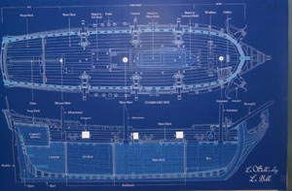
Interphase
Go Back
Home
Cells perform their necessary functions during INTERPHASE of the cell cycle. During interphase, the cell’s DNA is being used as a blueprint to make proteins.

Slide 8
Interphase
Go Back
Home
Cells perform their necessary functions during INTERPHASE of the cell cycle. During interphase, the cell’s DNA is being used as a blueprint to make proteins.
This blueprint holds the instructions to build a boat.

Slide 9
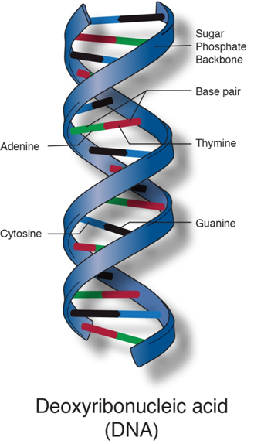
Interphase
Go Back
Home
Cells perform their necessary functions during INTERPHASE of the cell cycle. During interphase, the cell’s DNA is being used as a blueprint to make proteins.
DNA holds the instructions to make a protein.

Slide 10
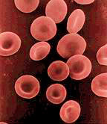
Interphase
Go Back
Home
Cells perform their necessary functions during INTERPHASE of the cell cycle. During interphase, the cell’s DNA is being used as a blueprint to make proteins.
The proteins made during interphase, help red blood cells carry oxygen.
Vein
RBC
RBC

Slide 11
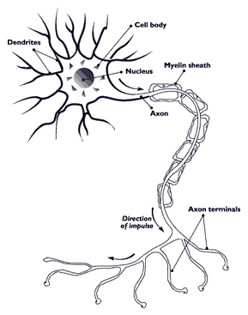
Interphase
Go Back
Home
Cells perform their necessary functions during INTERPHASE of the cell cycle. During interphase, the cell’s DNA is being used as a blueprint to make proteins.
The proteins made during interphase, help red blood cells carry oxygen.
The proteins made during interphase, help nerve cells send message to and from the brain.

Slide 12
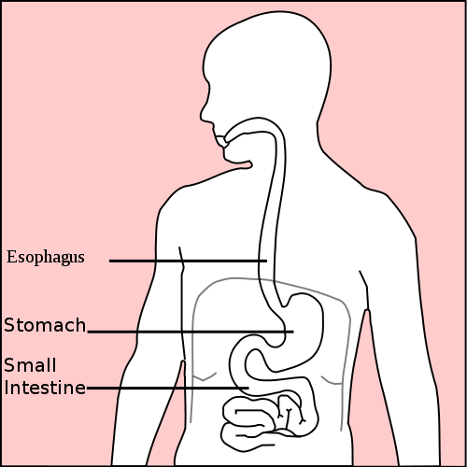
Interphase
Go Back
Home
Cells perform their necessary functions during INTERPHASE of the cell cycle. During interphase, the cell’s DNA is being used as a blueprint to make proteins.
The proteins made during interphase, help red blood cells carry oxygen.
The proteins made during interphase, help nerve cells send message to and from the brain.
The proteins made during interphase, help stomach cells secrete enzymes to digest your food.

Slide 13
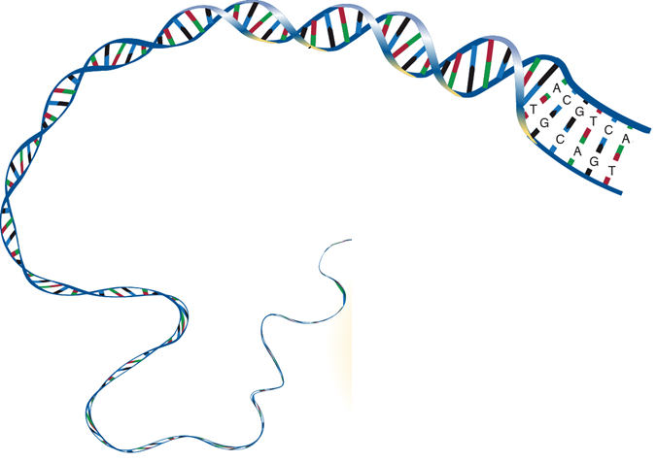
Interphase
Go Back
Home
Cells perform their necessary functions during INTERPHASE of the cell cycle. During interphase, the cell’s DNA is being used as a blueprint to make proteins.
The proteins made during interphase, help red blood cells carry oxygen.
The proteins made during interphase, help nerve cells send message to and from the brain.
The proteins made during interphase, help stomach cells secrete enzymes to digest your food.
In order for your cells to make these needed proteins, the DNA must be in a loose form called chromatin.
DNA as loose chromatin.

Slide 14
Interphase
Go Back
Home
In this animation, the cell contains 4 strands of chromatin.

Slide 15
Interphase
Go Back
Home
In this animation, the cell contains 4 strands of chromatin.
two chromatin strands in black…
two chromatin strands in red…

Slide 16
Interphase
Go Back
Home
In this animation, the cell contains 4 strands of chromatin.
During the S stage of interphase, the chromatin will duplicate, doubling the amount of DNA strands.
two chromatin strands in black…
two chromatin strands in red…

Slide 17
Interphase
Go Back
Home
In this animation, the cell contains 4 strands of chromatin.
During the S stage of interphase, the chromatin will duplicate, doubling the amount of DNA strands.
Now there are 8 total strands of chromatin.

Slide 18
Prophase of Mitosis
Go Back
Home
Prophase marks the start of mitosis.

Slide 19
Prophase of Mitosis
Go Back
Home
Prophase marks the start of mitosis.
During mitosis, cells will stop performing their normal functions and will focus on division. Stomach cells stop secreting digestive enzymes as they go through the mitosis.

Slide 20
Prophase of Mitosis
Go Back
Home
Prophase marks the start of mitosis.
During mitosis, cells will stop performing their normal functions and will focus on division. Stomach cells stop secreting digestive enzymes as they go through the mitosis.
The reason the cell stops performing its function is because the cell will package it’s DNA for transport. The loose chromatin that exists at the start of prophase, will condense into easily moveable, compact structures called chromosomes.

Slide 21
Prophase of Mitosis
Go Back
Home
Prophase marks the start of mitosis.
During mitosis, cells will stop performing their normal functions and will focus on division. Stomach cells stop secreting digestive enzymes as they go through the mitosis.
The reason the cell stops performing its function is because the cell will package it’s DNA for transport. The loose chromatin that exists at the start of prophase, will condense into easily moveable, compact structures called chromosomes.
The 8 strands of chromatin condense into 4 chromosomes.

Slide 22
Prophase of Mitosis
Go Back
Home
Prophase marks the start of mitosis.
During mitosis, cells will stop performing their normal functions and will focus on division. Stomach cells stop secreting digestive enzymes as they go through the mitosis.
The reason the cell stops performing its function is because the cell will package it’s DNA for transport. The loose chromatin that exists at the start of prophase, will condense into easily moveable, compact structures called chromosomes.
During prophase, the nucleus dissolves and spindle fibers form.

Slide 23
Prophase of Mitosis
Go Back
Home
Prophase marks the start of mitosis.
During mitosis, cells will stop performing their normal functions and will focus on division. Stomach cells stop secreting digestive enzymes as they go through the mitosis.
The reason the cell stops performing its function is because the cell will package it’s DNA for transport. The loose chromatin that exists at the start of prophase, will condense into easily moveable, compact structures called chromosomes.
During prophase, the nucleus dissolves and spindle fibers form.
Nucleus dissolves

Slide 24
Metaphase of Mitosis
Go Back
Home
During metaphase, the spindle fibers will connect to the centromere location of every chromosome.

Slide 25
Metaphase of Mitosis
Go Back
Home
During metaphase, the spindle fibers will connect to the centromere location of every chromosome.
Then, the spindle fibers will pull the chromosomes to the equator of the cell.

Slide 26
Metaphase of Mitosis
Go Back
Home
During metaphase, the spindle fibers will connect to the centromere location of every chromosome.
Then, the spindle fibers will pull the chromosomes to the equator of the cell.
Chromosomes are pulled to the equator

Slide 27
Anaphase of Mitosis
Go Back
Home
Remember that every chromosome is made from two halves called chromatids.

Slide 28
Anaphase of Mitosis
Go Back
Home
Remember that every chromosome is made from two halves called chromatids.
Now that the chromosomes are aligned along the equator, the spindle fibers will pull apart the chromatids of every chromosome.

Slide 29
Anaphase of Mitosis
Go Back
Home
Remember that every chromosome is made from two halves called chromatids.
Now that the chromosomes are aligned along the equator, the spindle fibers will pull apart the chromatids of every chromosome.
Chromatids pulled to opposite ends of the cell.

Slide 30
Telophase of Mitosis
Go Back
Home
Now that the chromatids are moved to opposite ends of the cell, the following events happen:

Slide 31
Telophase of Mitosis
Go Back
Home
Now that the chromatids are moved to opposite ends of the cell, the following events happen:
The cytoplasm divides during cytokinesis. This will split the cell in half.

Slide 32
Telophase of Mitosis
Go Back
Home
Now that the chromatids are moved to opposite ends of the cell, the following events happen:
The chromatids unwind into loose strands of chromatin.

Slide 33
Telophase of Mitosis
Go Back
Home
Now that the chromatids are moved to opposite ends of the cell, the following events happen:
The nucleus regrows in both cells.

Slide 34
Telophase of Mitosis
Go Back
Home
Now that the chromatids are moved to opposite ends of the cell, the following events happen:
Now that mitosis is finished, the one diploid cell has divided into two diploid cells.

Slide 35
Telophase of Mitosis
Go Back
Home
Now that the chromatids are moved to opposite ends of the cell, the following events happen:
Now that mitosis is finished, the one diploid cell has divided into two diploid cells.
Somatic, or non-sex cells, are examples of cells that divide by mitosis.

Slide 36
Telophase of Mitosis
Go Back
Home
Now that the chromatids are moved to opposite ends of the cell, the following events happen:
Now that mitosis is finished, the one diploid cell has divided into two diploid cells.
Somatic, or non-sex cells, are examples of cells that divide by mitosis.
Muscle cells,
Nerve cells,
Stomach cells,
Skin cells,
Blood cells, are all examples of somatic and diploid cells. The only cells that are not created by mitosis are sperm and egg cells. Sperm and egg divide by meiosis.

Slide 37
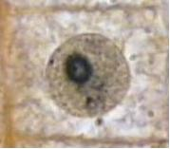
Mitosis Quiz
Go Back
Home
1) Here is a picture of interphase. Which choice happens during interphase?
DNA is copied
Chromatin condenses into chromosomes
Cytokinesis splits the cytoplasm
Nucleus dissolves
Chromosomes align at equator
Correct.
No. This is prophase.
No. This is telophase.
No. This is prophase.
No. This is metaphase

Slide 38
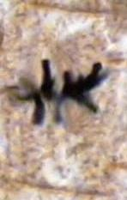
Mitosis Quiz
Go Back
Home
2) Which stage of the cell cycle is this?
Interphase
Prophase
Metaphase
Anaphase
Telophase
Correct.
No
No
No
No

Slide 39
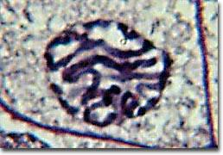
Mitosis Quiz
Go Back
Home
3) This is a picture or prophase. Which choice happens during prophase?
DNA is copied
Chromatin condenses into chromosomes
Cytokinesis splits the cytoplasm
Chromatids pulled to ends of cell
Chromosomes align at equator
Correct.
No. This is interphase.
No. This is telophase.
No. This is anaphase.
No. This is metaphase

Slide 40
Mitosis Quiz
Go Back
Home
4) Which stage of the cell cycle is this?
Interphase
Prophase
Metaphase
Anaphase
Telophase
Correct.
No
No
No
No

Slide 41
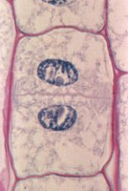
Mitosis Quiz
Go Back
Home
5) Here is a picture of telophase. Which choice does NOT happen in telophase?
Nucleus regrows
Cytokinesis divides the cytoplasm
Chromatids unwind into chromatin
Chromosomes align at equator.
No
No
No
Correct. This happens in metaphase.

Slide 42
Now for Meiosis
Go Back
Home
1
2
So now lets focus on Meiosis. Meiosis is the process for making haploid cells. Haploid cells are cells that contain only half the number of chromosomes for that species.
_

Slide 43
Now for Meiosis
Go Back
Home
So now lets focus on Meiosis. Meiosis is the process for making haploid cells. Haploid cells are cells that contain only half the number of chromosomes for that species.
For example, human diploid cells contain 46 chromosomes.

Slide 44
Now for Meiosis
Go Back
Home
So now lets focus on Meiosis. Meiosis is the process for making haploid cells. Haploid cells are cells that contain only half the number of chromosomes for that species.
For example, human diploid cells contain 46 chromosomes.
Paired chromosomes = diploid

Slide 45
Now for Meiosis
Go Back
Home
So now lets focus on Meiosis. Meiosis is the process for making haploid cells. Haploid cells are cells that contain only half the number of chromosomes for that species.
For example, human diploid cells contain 46 chromosomes.
Paired chromosomes = diploid

Slide 46
Now for Meiosis
Go Back
Home
So now lets focus on Meiosis. Meiosis is the process for making haploid cells. Haploid cells are cells that contain only half the number of chromosomes for that species.
For example, human diploid cells contain 46 chromosomes.
Paired chromosomes = diploid

Slide 47
Now for Meiosis
Go Back
Home
So now lets focus on Meiosis. Meiosis is the process for making haploid cells. Haploid cells are cells that contain only half the number of chromosomes for that species.
For example, human diploid cells contain 46 chromosomes.
Paired chromosomes = diploid

Slide 48
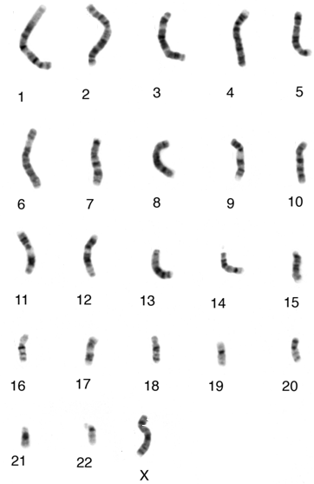
Now for Meiosis
Go Back
Home
So now lets focus on Meiosis. Meiosis is the process for making haploid cells. Haploid cells are cells that contain only half the number of chromosomes for that species.
For example, human diploid cells contain 46 chromosomes.
But human haploid cells contain only 23 chromosomes.

Slide 49
Now for Meiosis
Go Back
Home
So now lets focus on Meiosis. Meiosis is the process for making haploid cells. Haploid cells are cells that contain only half the number of chromosomes for that species.
For example, human diploid cells contain 46 chromosomes.
But human haploid cells contain only 23 chromosomes.
Single chromosome = haploid

Slide 50
Now for Meiosis
Go Back
Home
So now lets focus on Meiosis. Meiosis is the process for making haploid cells. Haploid cells are cells that contain only half the number of chromosomes for that species.
For example, human diploid cells contain 46 chromosomes.
But human haploid cells contain only 23 chromosomes.
Single chromosome = haploid

Slide 51
Now for Meiosis
Go Back
Home
So now lets focus on Meiosis. Meiosis is the process for making haploid cells. Haploid cells are cells that contain only half the number of chromosomes for that species.
For example, human diploid cells contain 46 chromosomes.
But human haploid cells contain only 23 chromosomes.
Single chromosome = haploid

Slide 52
Now for Meiosis
Go Back
Home
So now lets focus on Meiosis. Meiosis is the process for making haploid cells. Haploid cells are cells that contain only half the number of chromosomes for that species.
For example, human diploid cells contain 46 chromosomes.
But human haploid cells contain only 23 chromosomes.
Single chromosome = haploid

Slide 53
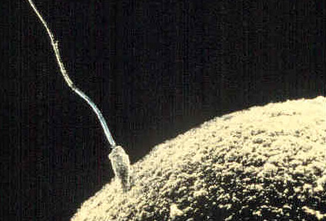
Now for Meiosis
Go Back
Home
So now lets focus on Meiosis. Meiosis is the process for making haploid cells. Haploid cells are cells that contain only half the number of chromosomes for that species.
For example, human diploid cells contain 46 chromosomes.
But human haploid cells contain only 23 chromosomes.
Examples of haploid cells are the gametes. Gametes are sex cells such as sperm cells in males. And egg cells, or ovum, in females.

Slide 54
Now for Meiosis
Go Back
Home
So now lets focus on Meiosis. Meiosis is the process for making haploid cells. Haploid cells are cells that contain only half the number of chromosomes for that species.
For example, human diploid cells contain 46 chromosomes.
But human haploid cells contain only 23 chromosomes.
Examples of haploid cells are the gametes. Gametes are sex cells such as sperm cells in males. And egg cells, or ovum, in females.
Sperm is the male gamete

Slide 55
Now for Meiosis
Go Back
Home
So now lets focus on Meiosis. Meiosis is the process for making haploid cells. Haploid cells are cells that contain only half the number of chromosomes for that species.
For example, human diploid cells contain 46 chromosomes.
But human haploid cells contain only 23 chromosomes.
Examples of haploid cells are the gametes. Gametes are sex cells such as sperm cells in males. And egg cells, or ovum, in females.
Sperm is the male gamete
The ovum (egg) is the female gamete

Slide 56
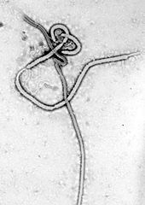
Germ Cells
Go Back
Home
Germ cells are not what you think they are. When we think germs, we think bacteria and viruses.

Slide 57
Germ Cells
Go Back
Home
Germ cells are not what you think they are. When we think germs, we think bacteria and viruses.
Ebola virus

Slide 58
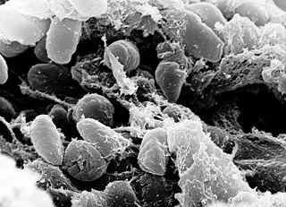
Germ Cells
Go Back
Home
Germ cells are not what you think they are. When we think germs, we think bacteria and viruses.
The bacteria that caused the Bubonic Plague

Slide 59
Germ Cells
Go Back
Home
Germ cells are not what you think they are. When we think germs, we think bacteria and viruses.
In this case, germ cells are the diploid cells that go through meiosis.

Slide 60
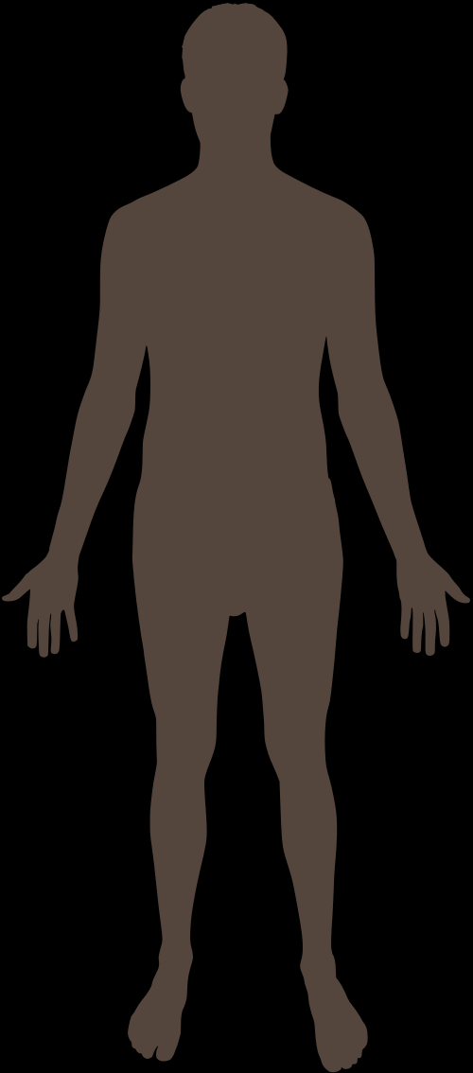
Germ Cells
Go Back
Home
Germ cells are not what you think they are. When we think germs, we think bacteria and viruses.
In this case, germ cells are the diploid cells that go through meiosis.
Males have germ cells in their testes. The male germ cells will go through meiosis to make sperm cells.

Slide 61
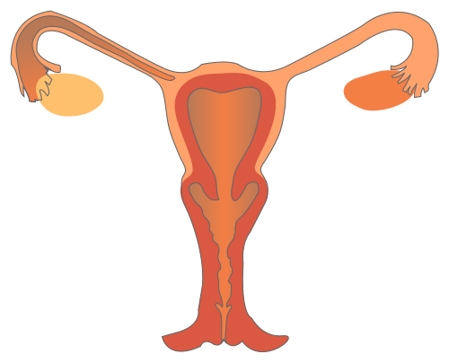
Germ Cells
Go Back
Home
Germ cells are not what you think they are. When we think germs, we think bacteria and viruses.
In this case, germ cells are the diploid cells that go through meiosis.
Males have germ cells in their testes. The male germ cells will go through meiosis to make sperm cells.
Females have germ cells in their ovaries. The female germ cells will go through meiosis to make egg cells.

Slide 62
Germ Cells
Go Back
Home
Germ cells are not what you think they are. When we think germs, we think bacteria and viruses.
In this case, germ cells are the diploid cells that go through meiosis.
Males have germ cells in their testes. The male germ cells will go through meiosis to make sperm cells.
Females have germ cells in their ovaries. The female germ cells will go through meiosis to make egg cells.
Lets discuss interphase, which happens before meiosis.

Slide 63
Interphase
Go Back
Home
In this animation, the cell contains 4 strands of chromatin.

Slide 64
Interphase
Go Back
Home
In this animation, the cell contains 4 strands of chromatin.
two chromatin strands in black…
two chromatin strands in red…

Slide 65
Interphase
Go Back
Home
In this animation, the cell contains 4 strands of chromatin.
During the S stage of interphase, the chromatin will duplicate, doubling the amount of DNA strands.
two chromatin strands in black…
two chromatin strands in red…

Slide 66
Interphase
Go Back
Home
In this animation, the cell contains 4 strands of chromatin.
During the S stage of interphase, the chromatin will duplicate, doubling the amount of DNA strands.
Now there are 8 total strands of chromatin.

Slide 67
Interphase
Go Back
Home
In this animation, the cell contains 4 strands of chromatin.
During the S stage of interphase, the chromatin will duplicate, doubling the amount of DNA strands.
In case you didn’t notice…
There’s really no difference between interphase prior to mitosis and interphase prior to meiosis.

Slide 68
Prophase 1 of Meiosis
Go Back
Home
Prophase 1 marks the start of meiosis.

Slide 69
Prophase 1 of Meiosis
Go Back
Home
Prophase 1 marks the start of meiosis.
Just like in prophase of mitosis, the nucleus will dissolve…

Slide 70
Prophase 1 of Meiosis
Go Back
Home
Prophase 1 marks the start of meiosis.
Just like in prophase of mitosis, the nucleus will dissolve…
The nucleus dissolves

Slide 71
Prophase 1 of Meiosis
Go Back
Home
Prophase 1 marks the start of meiosis.
Just like in prophase of mitosis, the nucleus will dissolve…
Just like in prophase of mitosis, the chromatin will condense into compact structures called chromosomes.

Slide 72
Prophase 1 of Meiosis
Go Back
Home
Prophase 1 marks the start of meiosis.
Just like in prophase of mitosis, the nucleus will dissolve…
Just like in prophase of mitosis, the chromatin will condense into compact structures called chromosomes.
Mom 1
Dad 1
Mom 2
Dad 2
8 strands of chromatin condense into 4 chromosomes

Slide 73
Prophase 1 of Meiosis
Go Back
Home
Prophase 1 marks the start of meiosis.
Just like in prophase of mitosis, the nucleus will dissolve…
Just like in prophase of mitosis, the chromatin will condense into compact structures called chromosomes.
Here is where meiosis and mitosis start to differ. An event called synapsis happens next.
Mom 1
Dad 1
Mom 2
Dad 2

Slide 74
Prophase 1 of Meiosis
Go Back
Home
Prophase 1 marks the start of meiosis.
Just like in prophase of mitosis, the nucleus will dissolve…
Just like in prophase of mitosis, the chromatin will condense into compact structures called chromosomes.
Here is where meiosis and mitosis start to differ. An event called synapsis happens next.
During synapsis, the two chromosome number 1’s are pulled next to each other. The same thing happens with the chromosome number 2’s.
Mom 1
Dad 1
Mom 2
Dad 2

Slide 75
Prophase 1 of Meiosis
Go Back
Home
Prophase 1 marks the start of meiosis.
Just like in prophase of mitosis, the nucleus will dissolve…
Just like in prophase of mitosis, the chromatin will condense into compact structures called chromosomes.
Here is where meiosis and mitosis start to differ. An event called synapsis happens next.
During synapsis, the two chromosome number 1’s are pulled next to each other. The same thing happens with the chromosome number 2’s.
Mom 1
Dad 1
Mom 2
Dad 2
Synapsis

Slide 76
Tetrads
Go Back
Home
Now that both chromosome 1’s have been paired…
Mom 1
Dad 1
Dad 2
Mom 2

Slide 77
Tetrads
Go Back
Home
Now that both chromosome 1’s have been paired…
Now that both chromosome 2’s have been paired…
Mom 1
Dad 1
Dad 2
Mom 2

Slide 78
Tetrads
Go Back
Home
Now that both chromosome 1’s have been paired…
Now that both chromosome 2’s have been paired…
These grouping of chromosomes are called a tetrad.
Mom 1
Dad 1
tetrad
tetrad
Dad 2
Mom 2

Slide 79
Tetrads
Go Back
Home
Now that both chromosome 1’s have been paired…
Now that both chromosome 2’s have been paired…
These grouping of chromosomes are called a tetrad.
Tetra is a prefix that means “4”. Notice how every tetrad is made from 2 chromosomes. But since every chromosome is made from 2 chromatids, there are 4 chromatids in every tetrad.
Mom 1
Dad 1
tetrad
tetrad
Dad 2
Mom 2

Slide 80
Tetrads
Go Back
Home
Now that both chromosome 1’s have been paired…
Now that both chromosome 2’s have been paired…
These grouping of chromosomes are called a tetrad.
Tetra is a prefix that means “4”. Notice how every tetrad is made from 2 chromosomes. But since every chromosome is made from 2 chromatids, there are 4 chromatids in every tetrad.
Why does synapsis happen? This happens because it sets up the next event called crossing over.
Mom 1
Dad 1
tetrad
tetrad
Dad 2
Mom 2

Slide 81
Crossing Over
Go Back
Home
Lets zoom into one of the tetrads.
Mom 1
Dad 1
tetrad
tetrad
Dad 2
Mom 2

Slide 82
Crossing Over
Go Back
Home
Lets zoom into one of the tetrads.
During crossing over, enzymes will break off a small portion of chromosome #1 that you inherited from your mother…
Mom #1
Dad #1

Slide 83
Crossing Over
Go Back
Home
Lets zoom into one of the tetrads.
During crossing over, enzymes will break off a small portion of chromosome #1 that you inherited from your mother…
Mom #1
Dad #1

Slide 84
Crossing Over
Go Back
Home
Lets zoom into one of the tetrads.
During crossing over, enzymes will break off a small portion of chromosome #1 that you inherited from your mother…
Enzymes will break off a small portion of chromosome #1 that you inherited from your father…
Mom #1
Dad #1

Slide 85
Crossing Over
Go Back
Home
Lets zoom into one of the tetrads.
During crossing over, enzymes will break off a small portion of chromosome #1 that you inherited from your mother…
Enzymes will break off a small portion of chromosome #1 that you inherited from your father…
Mom #1
Dad #1

Slide 86
Crossing Over
Go Back
Home
Lets zoom into one of the tetrads.
During crossing over, enzymes will break off a small portion of chromosome #1 that you inherited from your mother…
Enzymes will break off a small portion of chromosome #1 that you inherited from your father…
Next, the broken chromosome fragments will attach to the opposite chromosome.
Mom #1
Dad #1

Slide 87
Crossing Over
Go Back
Home
Lets zoom into one of the tetrads.
During crossing over, enzymes will break off a small portion of chromosome #1 that you inherited from your mother…
Enzymes will break off a small portion of chromosome #1 that you inherited from your father…
Next, the broken chromosome fragments will attach to the opposite chromosome.
Mom #1
Dad #1

Slide 88
Crossing Over
Go Back
Home
Lets zoom into one of the tetrads.
During crossing over, enzymes will break off a small portion of chromosome #1 that you inherited from your mother…
Enzymes will break off a small portion of chromosome #1 that you inherited from your father…
Next, the broken chromosome fragments will attach to the opposite chromosome.
Lets zoom back out to the entire cell.
Mom #1
Dad #1

Slide 89
Crossing Over
Go Back
Home
Lets zoom into one of the tetrads.
During crossing over, enzymes will break off a small portion of chromosome #1 that you inherited from your mother…
Enzymes will break off a small portion of chromosome #1 that you inherited from your father…
Next, the broken chromosome fragments will attach to the opposite chromosome.
Lets zoom back out to the entire cell.
Crossing over will happen in the other tetrad as well.
Dad 2
Mom 2

Slide 90
Crossing Over
Go Back
Home
Lets zoom into one of the tetrads.
During crossing over, enzymes will break off a small portion of chromosome #1 that you inherited from your mother…
Enzymes will break off a small portion of chromosome #1 that you inherited from your father…
Next, the broken chromosome fragments will attach to the opposite chromosome.
Lets zoom back out to the entire cell.
Crossing over will happen in the other tetrad as well.
Dad 2
Mom 2

Slide 91
Crossing Over
Go Back
Home
Lets zoom into one of the tetrads.
During crossing over, enzymes will break off a small portion of chromosome #1 that you inherited from your mother…
Enzymes will break off a small portion of chromosome #1 that you inherited from your father…
Next, the broken chromosome fragments will attach to the opposite chromosome.
Lets zoom back out to the entire cell.
Crossing over will happen in the other tetrad as well.
Crossing over is important because it recombines DNA into new traits. This creates genetic diversity.

Slide 92
Metaphase 1 of Meiosis
Go Back
Home
During metaphase 1, spindle fibers will pull the tetrads to the equator of the cell.

Slide 93
Metaphase 1 of Meiosis
Go Back
Home
During metaphase 1, spindle fibers will pull the tetrads to the equator of the cell.
Tetrads pulled to equator.

Slide 94
Anaphase 1 of Meiosis
Go Back
Home
During anaphase 1, spindle fibers will pull the tetrads apart.

Slide 95
Anaphase 1 of Meiosis
Go Back
Home
During anaphase 1, spindle fibers will pull the tetrads apart.
One chromosome of a tetrad is pulled to the left… one chromosome of a tetrad is pulled to the right.

Slide 96
Anaphase 1 of Meiosis
Go Back
Home
During anaphase 1, spindle fibers will pull the tetrads apart.
One chromosome of a tetrad is pulled to the left… one chromosome of a tetrad is pulled to the right.
Tetrads pulled apart

Slide 97
Telophase 1 of Meiosis
Go Back
Home
During telophase 1, the nucleus will often regrow.

Slide 98
Telophase 1 of Meiosis
Go Back
Home
During telophase 1, the nucleus will often regrow.
Two nuclei regrow

Slide 99
Telophase 1 of Meiosis
Go Back
Home
During telophase 1, the nucleus will often regrow.
Cytokinesis will divide the cytoplasm into two separate cells.

Slide 100
Telophase 1 of Meiosis
Go Back
Home
During telophase 1, the nucleus will often regrow.
Cytokinesis will divide the cytoplasm into two separate cells.
Cytokinesis splits the cell in two

Slide 101
Telophase 1 of Meiosis
Go Back
Home
During telophase 1, the nucleus will often regrow.
Cytokinesis will divide the cytoplasm into two separate cells.
This will complete the first half of meiosis. However, the germ cells that undergo meiosis will divide once more.

Slide 102
Prophase 2 of Meiosis
Go Back
Home
The purpose of meiosis is to reduce the amount of DNA in the gametes by half. That is why another round of division is needed.

Slide 103
Prophase 2 of Meiosis
Go Back
Home
The purpose of meiosis is to reduce the amount of DNA in the gametes by half. That is why another round of division is needed.
During prophase 2, the following events happen:

Slide 104
Prophase 2 of Meiosis
Go Back
Home
The purpose of meiosis is to reduce the amount of DNA in the gametes by half. That is why another round of division is needed.
During prophase 2, the following events happen:
Spindle fibers are formed and the nuclei dissolve again.

Slide 105
Metaphase 2 of Meiosis
Go Back
Home
During metaphase 2, spindle fibers will pull the chromosomes to the equator of both cells.

Slide 106
Metaphase 2 of Meiosis
Go Back
Home
During metaphase 2, spindle fibers will pull the chromosomes to the equator of both cells.
Spindle fibers pull the chromosomes to equator

Slide 107
Anaphase 2 of Meiosis
Go Back
Home
Remember that every chromosome is made from 2 chromatids.

Slide 108
Anaphase 2 of Meiosis
Go Back
Home
Remember that every chromosome is made from 2 chromatids.
During anaphase 2, spindle fibers will pull apart the chromosomes.

Slide 109
Anaphase 2 of Meiosis
Go Back
Home
Remember that every chromosome is made from 2 chromatids.
During anaphase 2, spindle fibers will pull apart the chromosomes.
One chromatid will be pulled to each end of the cell.

Slide 110
Anaphase 2 of Meiosis
Go Back
Home
Remember that every chromosome is made from 2 chromatids.
During anaphase 2, spindle fibers will pull apart the chromosomes.
One chromatid will be pulled to each end of the cell.
Chromatids pulled to opposite ends of the cell

Slide 111
Telophase 2 of Meiosis
Go Back
Home
During telophase 2, the following events will happen:

Slide 112
Telophase 2 of Meiosis
Go Back
Home
During telophase 2, the following events will happen:
Cytokinesis will split the 2 cells into 4 cells.

Slide 113
Telophase 2 of Meiosis
Go Back
Home
During telophase 2, the following events will happen:
Cytokinesis will split the 2 cells into 4 cells.
The cytoplasm divides

Slide 114
Telophase 2 of Meiosis
Go Back
Home
During telophase 2, the following events will happen:
Cytokinesis will split the 2 cells into 4 cells.
The nucleus will regrow in all 4 cells.

Slide 115
Telophase 2 of Meiosis
Go Back
Home
During telophase 2, the following events will happen:
Cytokinesis will split the 2 cells into 4 cells.
The nucleus will regrow in all 4 cells.
Four nuclei regrow

Slide 116
Telophase 2 of Meiosis
Go Back
Home
During telophase 2, the following events will happen:
Cytokinesis will split the 2 cells into 4 cells.
The nucleus will regrow in all 4 cells.
The chromatids will unwind into loose strands of chromatin.

Slide 117
Telophase 2 of Meiosis
Go Back
Home
During telophase 2, the following events will happen:
Cytokinesis will split the 2 cells into 4 cells.
The nucleus will regrow in all 4 cells.
The chromatids will unwind into loose strands of chromatin.
Chromatids uncurl into chromatin

Slide 118
Telophase 2 of Meiosis
Go Back
Home
During telophase 2, the following events will happen:
Cytokinesis will split the 2 cells into 4 cells.
The nucleus will regrow in all 4 cells.
The chromatids will unwind into loose strands of chromatin.
When finished, notice…

Slide 119
Telophase 2 of Meiosis
Go Back
Home
1
2
During telophase 2, the following events will happen:
Cytokinesis will split the 2 cells into 4 cells.
The nucleus will regrow in all 4 cells.
The chromatids will unwind into loose strands of chromatin.
When finished, notice…
3
4
Four cells have been created.

Slide 120
Telophase 2 of Meiosis
Go Back
Home
During telophase 2, the following events will happen:
Cytokinesis will split the 2 cells into 4 cells.
The nucleus will regrow in all 4 cells.
The chromatids will unwind into loose strands of chromatin.
When finished, notice…
2
2
1
1
2
1
2
1
Four cells have been created.
The cells are haploid. The cells started with 4 strands of chromatin, but now they only have 2 strands.

Slide 121
Telophase 2 of Meiosis
Go Back
Home
During telophase 2, the following events will happen:
Cytokinesis will split the 2 cells into 4 cells.
The nucleus will regrow in all 4 cells.
The chromatids will unwind into loose strands of chromatin.
When finished, notice…
Four cells have been created.
The cells are haploid. The cells started with 4 strands of chromatin, but now they only have 2 strands.
Because of crossing over, each cell is unique. It has a different mix of red and black chromatin.

Slide 122
Meiosis Review Quiz
Go Back
Home
In which event are chromosomes paired with one another?
Mom #1
Dad #1
Crossing Over
Mitosis
Synapsis
Nope
Nope
Correct

Slide 123
Meiosis Review Quiz
Go Back
Home
The loose, linear strands of DNA are known as _____________.
Chromosomes
Chromatin
Chromatids
Nope
Correct
Nope

Slide 124
Meiosis Review Quiz
Go Back
Home
Which statement about meiosis is FALSE?
Meiosis makes diploid cells.
Correct
Meiosis makes 4 cells at a time.
This is a true statement.
Meiosis creates gametes.
This is a true statement.

Slide 125
Meiosis Review Quiz
Go Back
Home
During which event will chunks of one chromosome break away and connect to another chromosome?
Synapsis
Nope.
Crossing Over
Correct.
Cytokinesis
Nope.

Slide 126
Meiosis Review Quiz
Go Back
Home
Which cell would be created by meiosis?
Skin cell
Nope.
Muscle cell
Nope.
Correct. The ovum is the egg cell.
Ovum cell
Brain cell
Nope.

Slide 127
Meiosis Review Quiz
Go Back
Home
When does synapsis and crossing over happen during meiosis?
Metaphase 2
Nope.
Telophase 1
Nope.
Interphase
Nope.
Prophase 1
Correct.

Slide 128
Meiosis Review Quiz
Go Back
Home
In relation to meiosis, what are germ cells?
Cells that cause disease
Nope.
Cells that undergo meiosis
Correct
Cells that start and end haploid
Nope.
Cells that grow into a baby
Nope.

Slide 129
Finished
Go Back
Home
Check over your worksheet for any accidental blanks. Turn in your worksheet when finished.

